Slide 1
Don’t copy and paste, press ‘Run’: Automating regular reporting for the Radiotherapy Dataset
Louise Reynolds

Slide 2
RTDS: Radiotherapy Dataset
51 radiotherapy providers in England + 3 radiotherapy providers in Wales (patients with England postcode)
Collect and submit monthly standardised data
Provides intelligence for:
Service planning
Commissioning
Clinical practice and research
Operational provision of radiotherapy services

Slide 3
RTDS: Regular Reports
RTDS produces a number of internal and external reports
Internal snapshot QA (monthly)
Quality metrics (monthly, quarterly, annually)
NHS England reports (quarterly, annual)
Populations (annual)
Radiotherapy delivery in England dashboard (annual)
COVID-19 dashboard (monthly)

Slide 4


RTDS: Legacy Reporting Process
Produce Report
Export to .csv file
Pivot tables
Additional calculations
Copy and paste into final report template
QA Report
Compare to final report
Export to .csv file
Pivot tables
Additional calculations

Slide 5
Problems
Time consuming
Monthly snapshot QA: ~6 hours to produce
Quarterly report: 43 hours to produce (including QA)
Potential for human error
Monthly snapshot QA: 5 tabs of data
Quarterly report: 32 tabs of data
Not easily reproducible
Difficult to QA
Not interesting work

Slide 6







Automating Reports in R
Process documents

Slide 7
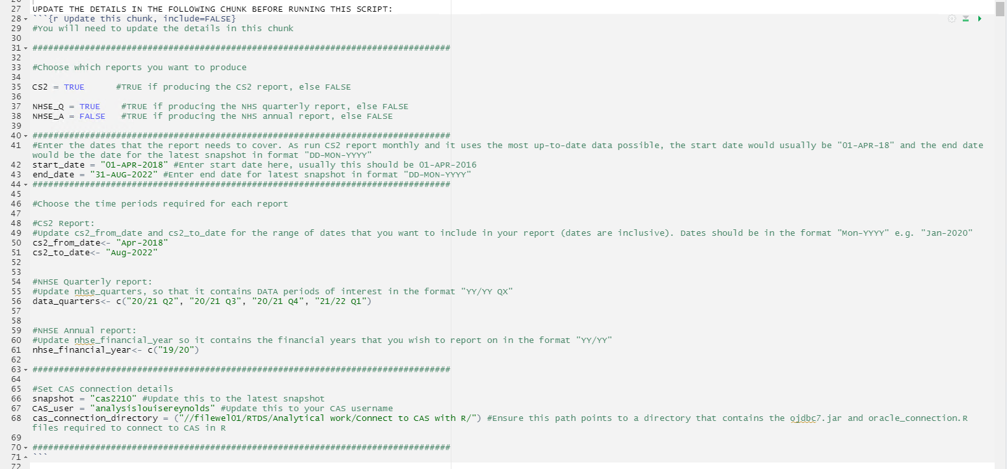
Example Script

Slide 8
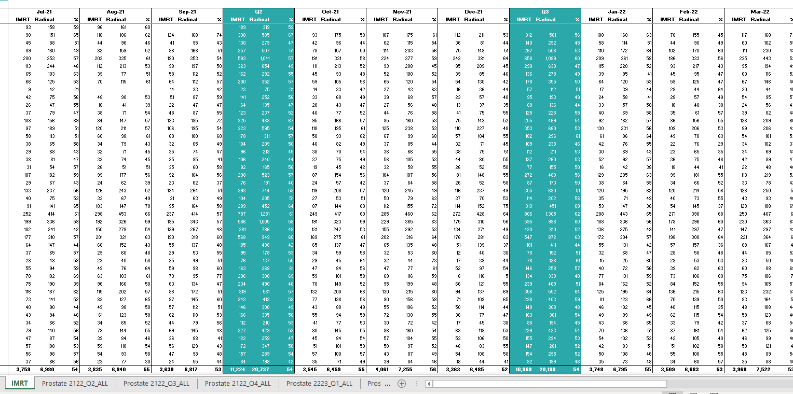
Example Report

Slide 9
Comments
May initially take more time to develop than existing methods
Has saved a lot of time
QA by running methods in parallel
Need staff with skills to make changes and keep up to date
Good upskilling opportunity
Potential to reuse functions across multiple reports
Next steps: - Automate more of the QA - Make open access via NHS Digital GitHub

Slide 10

Thank You
Kirstin Roberts
Michael Baser, Michelle Ward, Alex Kao, Catherine Okello

Slide 11
Thank You
Kirstin Roberts
Michael Baser, Michelle Ward, Alex Kao, Catherine Okello

